Slide 1
Python GUI

Slide 2
GUI
Python provides various options for developing graphical user interfaces (GUIs). Most important are listed below.
Tkinter − Tkinter is the Python interface to the Tk GUI toolkit shipped with Python. We would look this option in this chapter.
wxPython − This is an open-source Python interface for wxWindows http://wxpython.org.
JPython − JPython is a Python port for Java which gives Python scripts seamless access to Java class libraries on the local machine http://www.jython.org

Slide 3
Python GUI – tkinter
Python offers multiple options for developing GUI (Graphical User Interface). Out of all the GUI methods, tkinter is the most commonly used method. It is a standard Python interface to the Tk GUI toolkit shipped with Python. Python with tkinter is the fastest and easiest way to create the GUI applications. Creating a GUI using tkinter is an easy task. To create a tkinter app:
Importing the module – tkinter
Create the main window (container)
Add any number of widgets to the main window
Apply the event Trigger on the widgets.

Slide 4
Importing tkinter is same as importing any other module in the Python code. Note that the name of the module in Python 2.x is ‘Tkinter’ and in Python 3.x it is ‘tkinter’.
import tkinter
There are two main methods used which the user needs to remember while creating the Python application with GUI.
Tk(screenName=None, baseName=None, className=’Tk’, useTk=1):
To create a main window, tkinter offers a method ‘Tk(screenName=None, baseName=None, className=’Tk’, useTk=1)’.
To change the name of the window, you can change the className to the desired one. The basic code used to create the main window of the application is:
m=tkinter.Tk() where m is the name of the main window object
mainloop():
There is a method known by the name mainloop() is used when your application is ready to run. mainloop() is an infinite loop used to run the application, wait for an event to occur and process the event as long as the window is not closed.
m.mainloop()

Slide 5
There are mainly three geometry manager classes class.
pack() method: It organizes the widgets in blocks before placing in the parent widget.
grid() method: It organizes the widgets in grid (table-like structure) before placing in the parent widget.
place() method: It organizes the widgets by placing them on specific positions directed by the programmer.

Slide 6
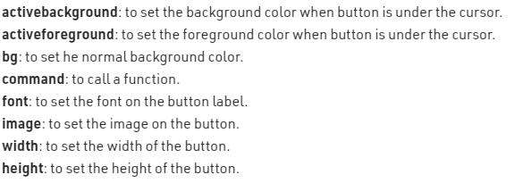
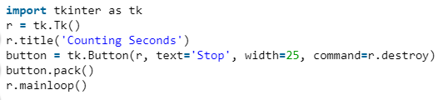
1. Button
To add a button in your application, this widget is used.
The general syntax is:
w=Button(master, option=value)
master is the parameter used to represent the parent window.
There are number of options which are used to change the format of the Buttons. Number of options can be passed as parameters separated by commas. Some of them are listed below.

Slide 7
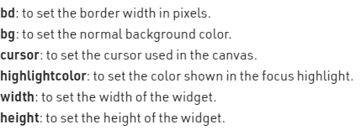
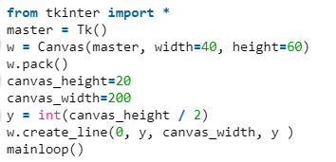
2. Canvas
It is used to draw pictures and other complex layout like graphics, text and widgets.
The general syntax is:
w = Canvas(master, option=value)
master is the parameter used to represent the parent window.
There are number of options which are used to change the format of the widget. Number of options can be passed as parameters separated by commas. Some of them are listed below.

Slide 8
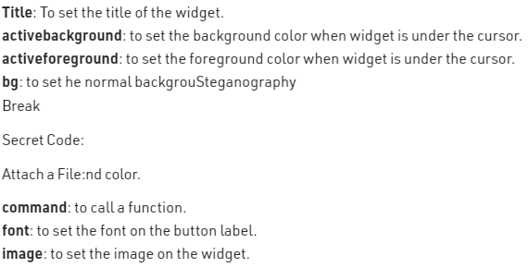
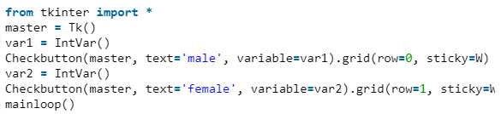
3. CheckButton
To select any number of options by displaying a number of options to a user as toggle buttons. The general syntax is:
w = CheckButton(master, option=value)
There are number of options which are used to change the format of this widget. Number of options can be passed as parameters separated by commas. Some of them are listed below.

Slide 9
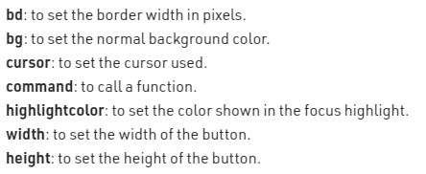
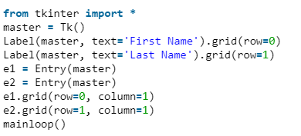
4. Entry
It is used to input the single line text entry from the user.. For multi-line text input, Text widget is used.
The general syntax is:
w=Entry(master, option=value)
master is the parameter used to represent the parent window.
There are number of options which are used to change the format of the widget.
Number of options can be passed as parameters separated by commas. Some of them are listed below.

Slide 10
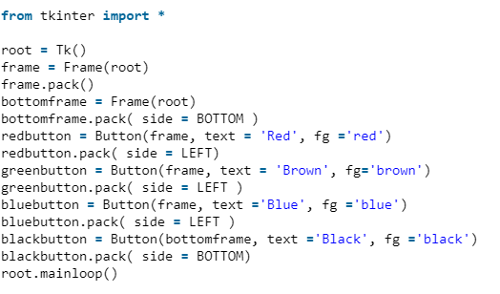
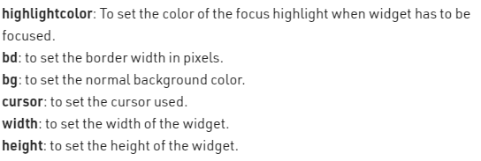
5. Frame
It acts as a container to hold the widgets. It is used for grouping and organizing the widgets. The general syntax is:
w = Frame(master, option=value)
master is the parameter used to represent the parent window.
There are number of options which are used to change the format of the widget. Number of options can be passed as parameters separated by commas. Some of them are listed below.

Slide 11
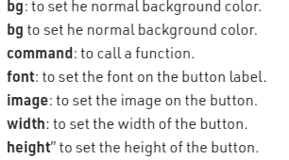
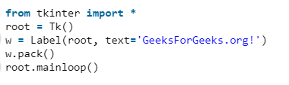
6. Label
It refers to the display box where you can put any text or image which can be updated any time as per the code.
The general syntax is:
w=Label(master, option=value)
master is the parameter used to represent the parent window.
There are number of options which are used to change the format of the widget. Number of options can be passed as parameters separated by commas. Some of them are listed below.

Slide 12
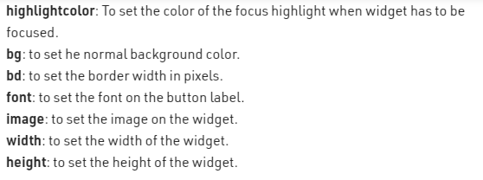
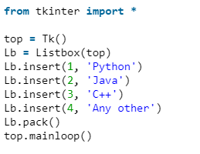
7. Listbox
It offers a list to the user from which the user can accept any number of options.
The general syntax is:
w = Listbox(master, option=value)
master is the parameter used to represent the parent window.
There are number of options which are used to change the format of the widget. Number of options can be passed as parameters separated by commas. Some of them are listed below.

Slide 13
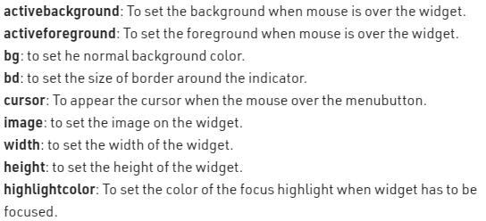
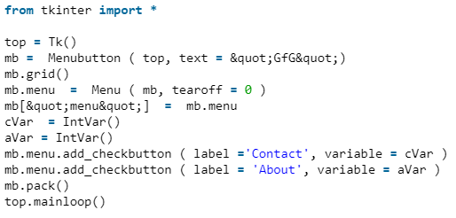
8. MenuButton
It is a part of top-down menu which stays on the window all the time. Every menubutton has its own functionality. The general syntax is:
w = MenuButton(master, option=value)
master is the parameter used to represent the parent window.
There are number of options which are used to change the format of the widget. Number of options can be passed as parameters separated by commas. Some of them are listed below.

Slide 14
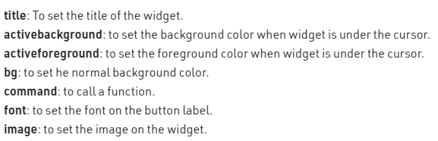
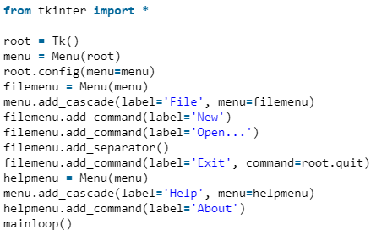
9. Menu
It is used to create all kinds of menus used by the application.
The general syntax is:
w = Menu(master, option=value)
master is the parameter used to represent the parent window.
There are number of options which are used to change the format of this widget. Number of options can be passed as parameters separated by commas. Some of them are listed below.

Slide 15
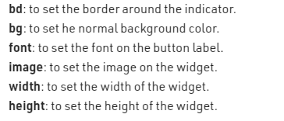
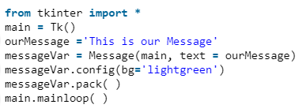
10. Message
It refers to the multi-line and non-editable text. It works same as that of Label. The general syntax is:
w = Message(master, option=value)
master is the parameter used to represent the parent window.
There are number of options which are used to change the format of the widget. Number of options can be passed as parameters separated by commas. Some of them are listed below.

Slide 16
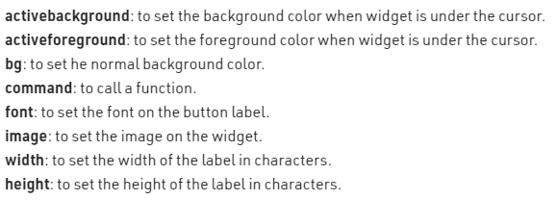
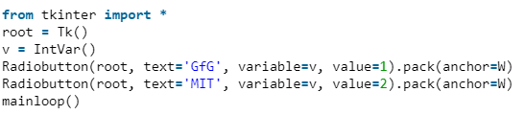
11. RadioButton
It is used to offer multi-choice option to the user. It offers several options to the user and the user has to choose one option.
The general syntax is:
w = RadioButton(master, option=value)
There are number of options which are used to change the format of this widget. Number of options can be passed as parameters separated by commas. Some of them are listed below.

